Slide 1
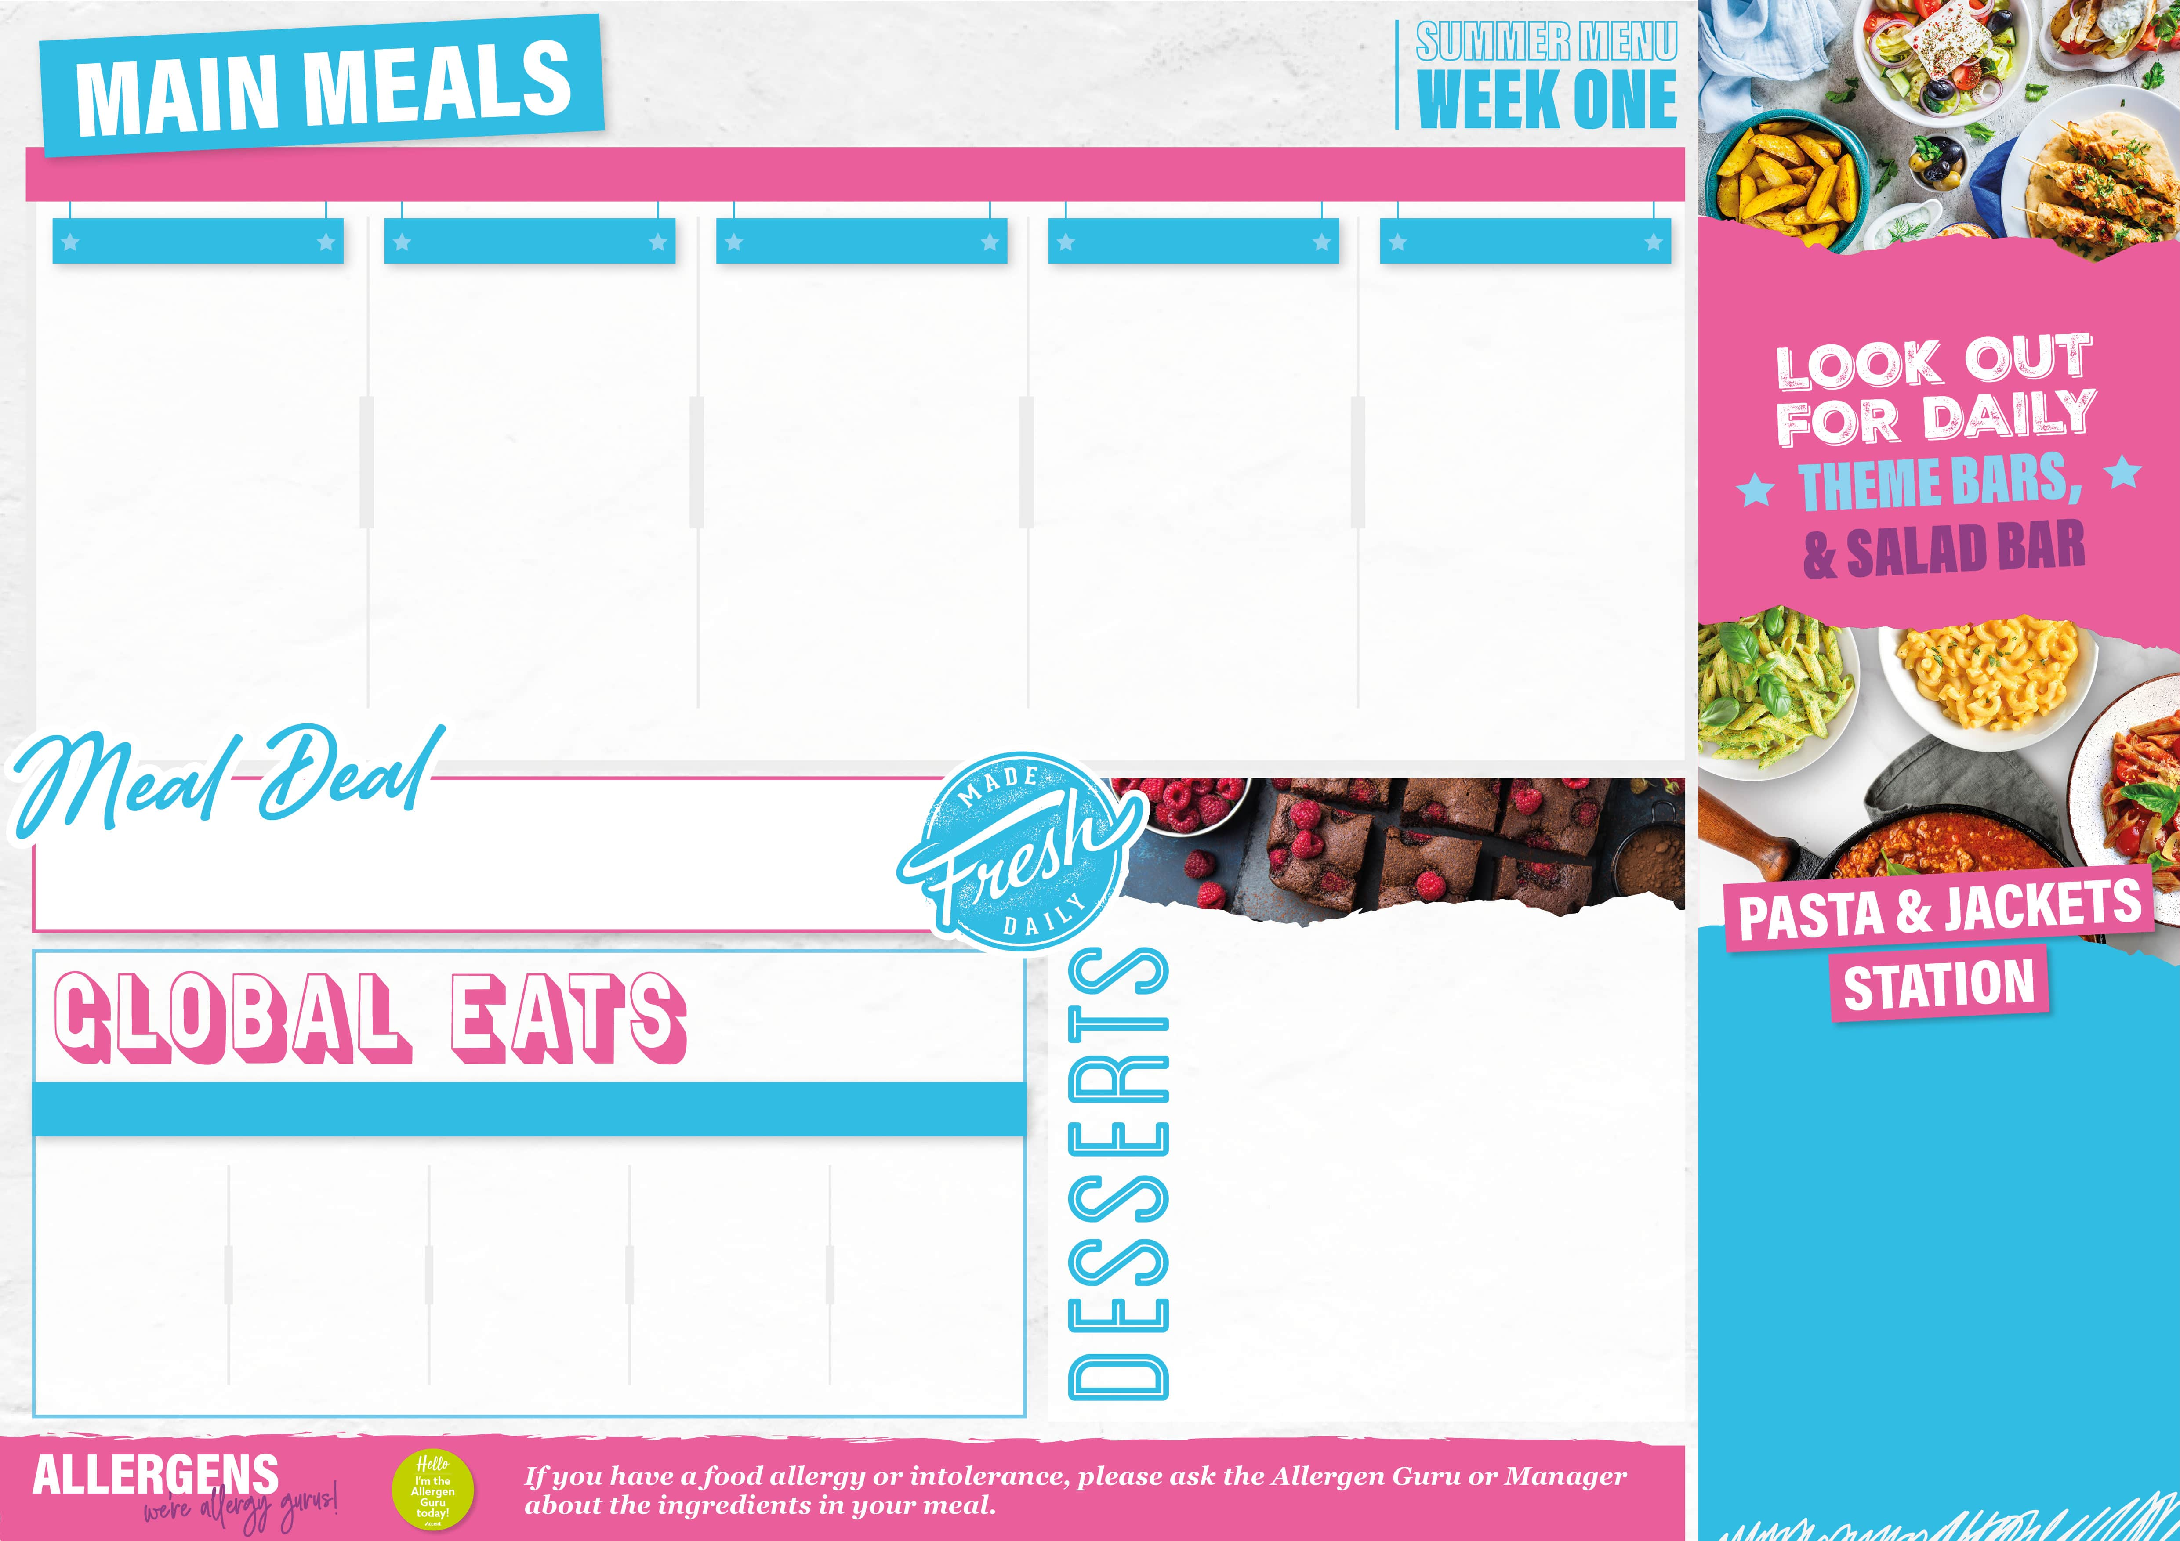
13/04/26,04/05/26,
01/06/26,22/06/26,
13/07/26
From £2.40
BRITISH CLASSICS
TASTE OF ASIA
MEXICAN MOMENTS
FUSION
CHIP SHOP
Butchers Sausages with Onion Gravy Grilled Veggie Sausages with Onion Gravy Creamy Mashed Potato Broccoli & Carrots Extras: Yorkshire Pudding | Singapore Chicken Laksa Curry Singapore Tofu & Vegetable Laksa Curry Noodles Asian Salad Extras: Prawn Crackers | Chilli Con Carne with Sour Cream Eat Curious Chilli Non-Carne with Sour Cream Zesty Lime & Coriander Rice Mexican Chopped Salad Extras: Soft or Crispy Tortilla | Crispy Panko Chicken Burger with Curry Mayo Crispy Onion Bhaji Burger with Curry Mayo Spicy Wedges House Slaw Extras: Cheese Slices | Battered Fish Fillet or Jumbo Sausage Cheese & Onion Turnover Chips Peas Baked Beans Extras: Curry Sauce
Only £2.70
Check out what’s on offer today, available for free school meals!
MONDAY
German Apple Cake
TUESDAY
Jammie Dodger Muffins
WEDNESDAY
Pear & Ginger Crunch Crumble & Custard
THURSDAY
Chocolate Pudding with Chocolate Sauce
FRIDAY
Biscoff & Buttercream Cake
From £2.85
MONDAY
Bolognaise, Basil Pesto, Macaroni Cheese, Creamy Chicken & Sweetcorn and Spicy Tomato Arrabbiata
TUESDAY
Bolognaise, Basil Pesto, Macaroni Cheese, Creamy Chicken & Sweetcorn and Spicy Tomato Arrabbiata
WEDNESDAY
Bolognaise, Basil Pesto, Macaroni Cheese, Creamy Chicken & Sweetcorn and Spicy Tomato Arrabbiata
THURSDAY
Bolognaise, Basil Pesto, Macaroni Cheese, Creamy Chicken & Sweetcorn and Spicy Tomato Arrabbiata
FRIDAY
Pizza Mac & Cheese with Garlic Bread
Portuguese Peri-Peri Chicken & Rice | Pepperoni Quesadilla with Spicy Nachos | Hot Roast Dinner Baguette with Chicken | Loaded Wedges with Sour Cream
From £1.10
From £2.35

Slide 2

20/04/26,11/05/26,08/06/26,29/06/26
From £2.40
SUNSHINE FAVOURITES
TASTE OF ITALY
MEXICAN MOMENTS
TASTE OF INDIA
CHIP SHOP
Caribbean Chicken with Pineapple Salsa Caribbean Squash & Sweet Potato with Pineapple Salsa Spicy Rice Jamaican Slaw Extras: Grilled Flatbread | Spaghetti and Meatballs Spaghetti and Veggie Meatballs Garlic & Herb Slice Roasted Garlic & Lemon Broccoli Extras: Grated Cheddar | Mexican Chipotle Pork Mexican Chipotle Beans Flour Tortillas Roasted Corn and Peppers Extras: Crispy Nachos | Chicken Tikka Biryani Crispy Paneer Vegetable Biryani Bombay Potatoes Indian Chutneys Extras: Naan Bread | Battered Fish Fillet or Chicken Tenders Vegetable Spring Roll Chips Peas Baked Beans Extras: Curry Sauce
Only £2.70
Check out what’s on offer today, available for free school meals!
MONDAY
Summer Berry Flapjack Bake
TUESDAY
Cookies & Cream Sponge
WEDNESDAY
Apple & Cinnamon Crumble with Ice Cream
THURSDAY
Raspberry & White Chocolate Cake
FRIDAY
Tiramisu Sponge
From £2.85
MONDAY
Bolognaise, Basil Pesto, Macaroni Cheese, Creamy Chicken & Sweetcorn and Spicy Tomato Arrabbiata
TUESDAY
Chicken Curry Rice Pot, Chilli Sin Carne Rice Pot
WEDNESDAY
Bolognaise, Basil Pesto, Macaroni Cheese, Creamy Chicken & Sweetcorn and Spicy Tomato Arrabbiata
THURSDAY
Bolognaise, Basil Pesto, Macaroni Cheese, Creamy Chicken & Sweetcorn and Spicy Tomato Arrabbiata
FRIDAY
Crunchy Cauliflower Mac and Cheese with Garlic Bread
Currywurst with Fries | Indonesian Chicken Stir Fried Rice | Lamb Kofta Pitta and Salad | Crispy Korean Chicken Baguette with Asian Salad
From £1.10
From £2.35

Slide 3
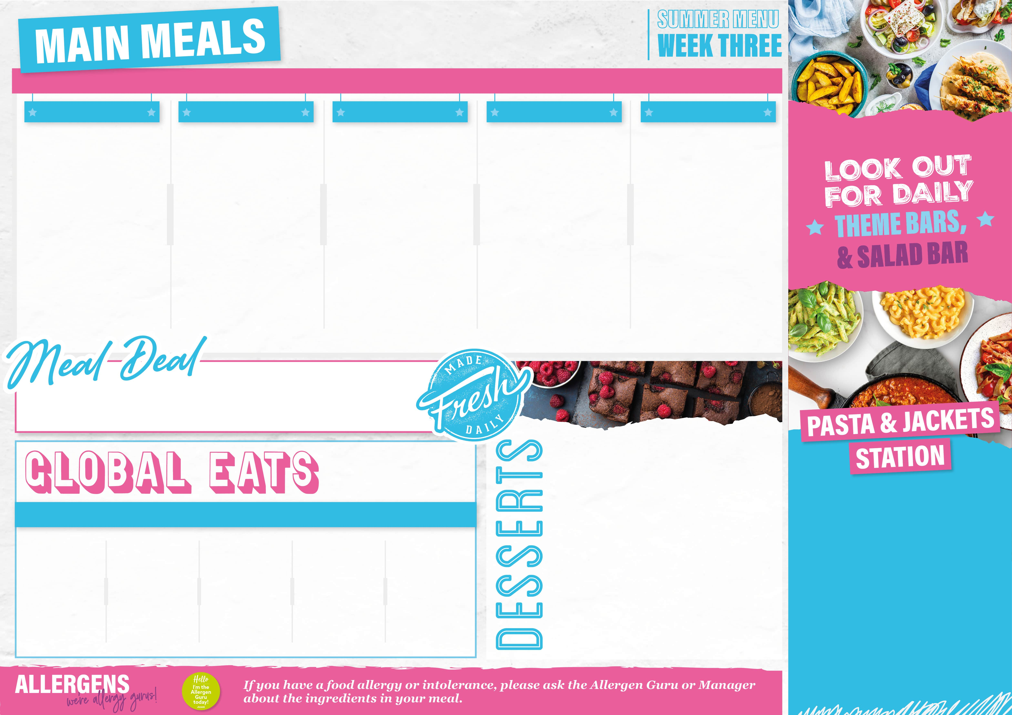
27/04/26,18/05/26,
16/06/26,06/07/26
From £2.40
TASTE OF GREECE
EURO CLASSICS
MOST OF ROAST
MIDDLE EASTERN
CHIP SHOP
Greek Lamb Pasta Bake Greek Veggie Mince Pasta Bake Chefs Seasonal Salad Extras: Garlic Bread | Hunter’s Chicken Tray Bake Hunters Vegetable Tray Bake Roasted Corn & Peppers Extras: Onion Rings | Herb Roast Chicken with Stuffing and Herb Gravy Roast Vegetable Wellington with Stuffing and Herb Gravy Extras: Yorkshire Pudding | Lebanese Chicken Shawarma Lebanese Eat Curious Shawarma Lemon & Herb Tabouleh Pitta Bread Extras: Seasoned Fries | Battered Fish Fillet or Sausage Roll Crispy Vegetable Samosa Chips Peas Baked Beans Extras: Curry Sauce
Only £2.70
Check out what’s on offer today, available for free school meals!
MONDAY
Double Chocolate Traybake
TUESDAY
Baked Crispy Apple Tart
WEDNESDAY
Lemon Drizzle Sponge
THURSDAY
Berry Queen Of Puddings
FRIDAY
Warm Choc Chip Shortbread Traybake
From £2.85
MONDAY
Panini Bar: Sweet Chilli Chicken, Pizza Melt, and Cheese
TUESDAY
Bolognaise, Basil Pesto, Macaroni Cheese, Creamy Chicken & Sweetcorn and Spicy Tomato Arrabbiata
WEDNESDAY
Bolognaise, Basil Pesto, Macaroni Cheese, Creamy Chicken & Sweetcorn and Spicy Tomato Arrabbiata
THURSDAY
Bolognaise, Basil Pesto, Macaroni Cheese, Creamy Chicken & Sweetcorn and Spicy Tomato Arrabbiata
FRIDAY
Mac & Cheese with Crushed Nachos and Salsa
Sticky Baked Chinese Wings with Rice | Pulled Pork Loaded Nachos | Chicken Saag Aloo | Meatball Sub
From £1.10
From £2.35

Slide 4

XX/XX/XX, XX/XX/XX,XX/XX/XX
From £0.00
BUILD A BURRITO
TASTE OF US
STIR IT UP
EURO CLASSICS
CHIP SHOP
Choose your Chilli: Chicken, Lamb or Beef Chilli Con Veggie Flour Tortilla Steamed Rice Jalapenos Sour Cream Salsa Extras: Grated Cheese | BBQ Hot Dogs with Crispy Onions Sticky BBQ Veggie Hot Dog with Crispy Onions Seasoned Wedges Chef Salad Extras: Onion Rings | Sticky Sweet and Sour Chicken Stir Fry Sticky Sweet and Sour Tofu Stir Fry Spring Onion and Ginger Noodles Extras: Prawn Crackers | Hunters Chicken Tray Bake Hunters Vegetable Tray Bake Green Beans Extras: Garlic Bread | Battered Fish Fillet or Chicken Tenders Signature Squashage Roll Chips Peas Baked Beans Extras: Curry Sauce
Only £x.xx
Check out what’s on offer today, available for free school meals!
MONDAY
Pear Flapjack Crumble
TUESDAY
Popcorn Brownie
WEDNESDAY
Berry Queen of Puddings
THURSDAY
Raspberry and White Chocolate Cake
FRIDAY
Oreo Cheesecake
From £0.00
MONDAY
Bolognaise, Basil Pesto, Macaroni Cheese, Creamy Chicken & Sweetcorn and Spicy Tomato Arrabbiata
TUESDAY
Bolognaise, Basil Pesto, Macaroni Cheese, Creamy Chicken & Sweetcorn and Spicy Tomato Arrabbiata
WEDNESDAY
Bolognaise, Basil Pesto, Macaroni Cheese, Creamy Chicken & Sweetcorn and Spicy Tomato Arrabbiata
THURSDAY
Bolognaise, Basil Pesto, Macaroni Cheese, Creamy Chicken & Sweetcorn and Spicy Tomato Arrabbiata
FRIDAY
Pepperoni Mac & Cheese
Korean Crispy Chicken Wrap with Asian Slaw | Jamaican Jerk Pork with Rice and Beans | Chilli Loaded Waffle Fries | Authentic Vegetable Paella
From £0.00
From £0.00

